Slide 1
Data Cycle Apartments
Rudolfo Cristo, Zanya Fernández Rodríguez, Laurentiu Pelea

Slide 2
Table of contents
01
02
03
04
Use case
System architecture
Data processing
Machine learning predictions
05
06
Automatization
PowerBI dashboards

Slide 3
01
Use case

Slide 4
Use case
Reference data from two Apartments
Sensors logs (movements, temperature, humidity, energy consumption, light)
Weather forecasts
Business objectives
Visualize power consumption and environmental data
Visualize room occupation
Forecast power consumption and room occupation
Notes:
Difficulties : Clean the data, organise it and transform. Get accurate predictions, make it easy for the Power BI part to use.

Slide 5
02
System architecture

Slide 6
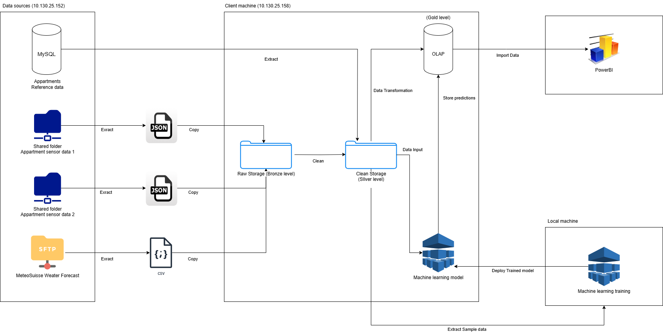

Slide 7
Medallion architecture
Bronze layer
Silver layer
Gold layer
The Bronze layer serves as our raw data ingestion zone, capturing data in its original format directly from source systems. This layer preserves the full fidelity of incoming data without transformation,
The Silver layer contains validated, cleansed, and transformed data from the Bronze layer. Here we standardize formats, remove duplicates, handle missing values,
The Gold layer delivers business-ready, aggregated data for specific use cases and consumption patterns. Gold data powers dashboards and reports,

Slide 8
03
Data processing

Slide 9
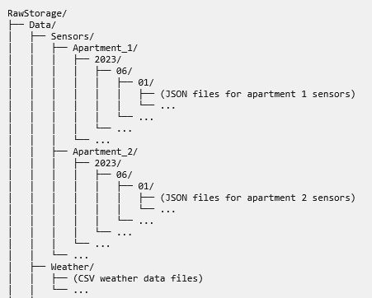
Bronze
Data acquisition layer
Multi-threaded approach to collect data from external sources
Implemented through Python scripts for different data sources
Stores data without modifications
Organizes files by data type, apartment, date
Duplicate prevention
Security considerations
Windows Credential Manager stores sensitive connection details
Access through Windows API
Hybrid configuration approach separates sensitive from non-sensitive settings

Slide 10
Silver
Data processing
Filtering
Normalize date formats
Converts all dates to standard "dd/mm/yyyy" format
Extracts time components to separate "Hours" fields
Replaces anomalous weather
Extracts relevant data for specific locations and devices
Selects only data for Sion and Visp weather locations
Validates against predefined list of valid rooms
Maintains separate logs for filtered-out data

Slide 11
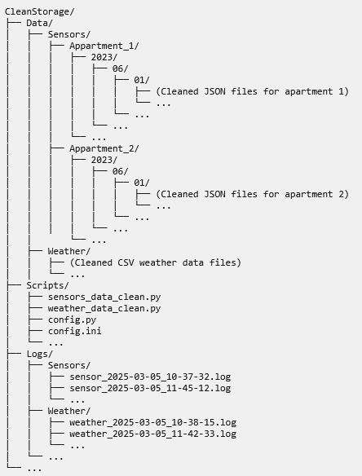
Silver
Implementation
Multi-threaded processing with 4 parallel workers (configurable)
Maintains same directory structure as Bronze layer
Detailed logging with execution metrics and success rates

Slide 12
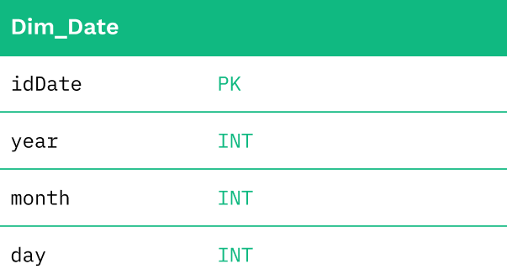
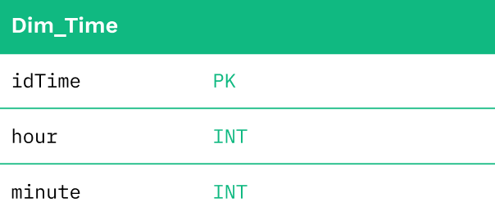
Gold: Dimensions used in all Fact tables

Slide 13
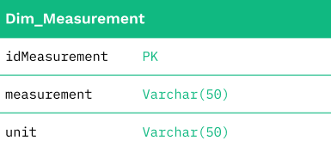
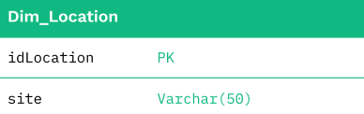
Gold: Dimensions used only in Weather table

Slide 14
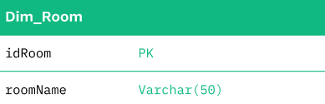
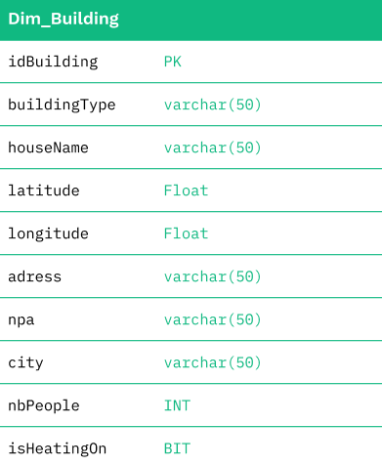
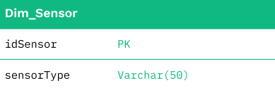
Gold: Dimensions used only in Sensors tables

Slide 15
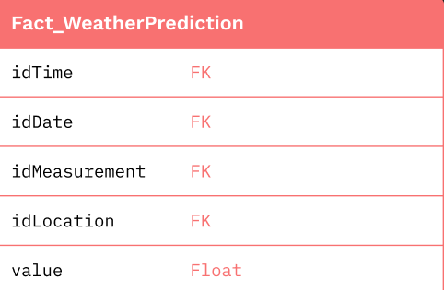
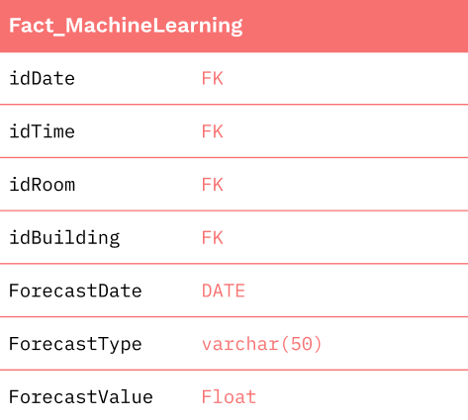
Gold: Weather, Machine learning Fact tables

Slide 16
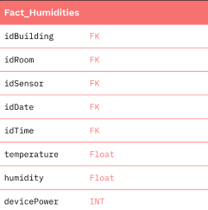
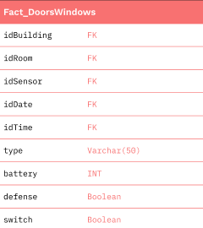
Gold: Sensors Fact tables

Slide 17
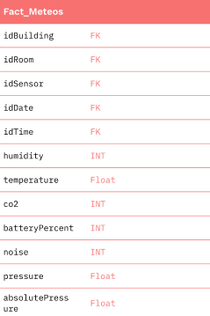
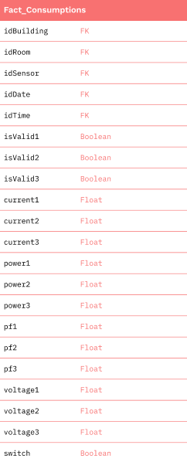
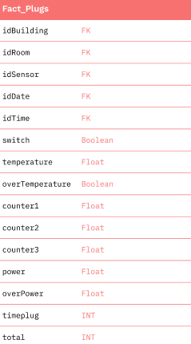
Gold: Sensors Fact tables

Slide 18
Data Loading
Configuration file | Defines paths for data sources and processing parameters.
Configuration manager | Manages sensitive connection details using Windows Credential Manager. Centralizes config loading and validation.
Load static data | Loads reference data including building types, buildings, rooms, and sensors into dimension tables.
Load sensors data | Processes apartment sensor data from JSON files. Implements multi-threaded processing to handle large volumes efficiently.
Load weather data | Transforms CSV-based weather prediction data into the warehouse structure. Implements incremental loading with error handling to ensure data integrity. Maintains file processing history to prevent duplication.
Load machine learning forecasts | Imports machine learning prediction data for room presence and power consumption. Maps results to appropriate dimensions and fact tables.

Slide 19
04
Machine learning

Slide 20
Power consumption prediction training
Extract and Combine data
Check for duplicates, missing values, outliers
Fix duplicates, missing values, outliers
Remove columns
Transform to hourly data
Add Weather data (csv)
Test stationarity
Feature engineering: Seasons, Lag, Lead, Rolling

Slide 21
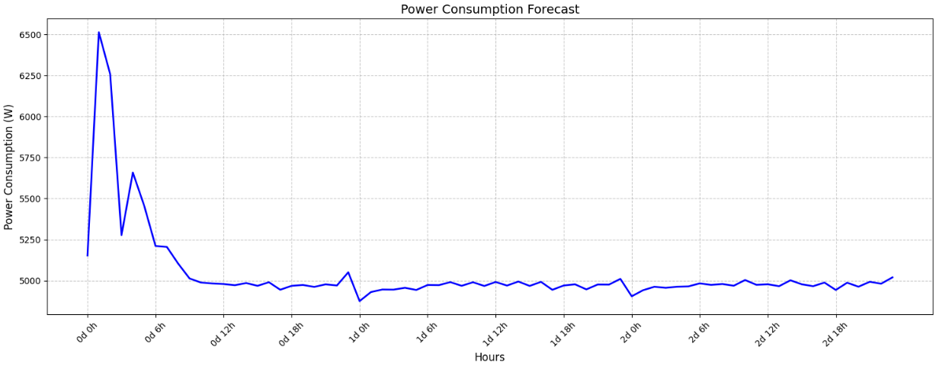
Power consumption prediction training
Define Features and Target
Train-Test split
Train and Evaluate models
Dump the models chosen

Slide 22
Room occupation prediction training
Extract and Combine data
Check for duplicates, missing values, outliers
Fix duplicates, missing values, outliers
Remove columns
Feature engineering: Presence features and label
Transform to hourly data
Test stationarity
Define Features and Target

Slide 23
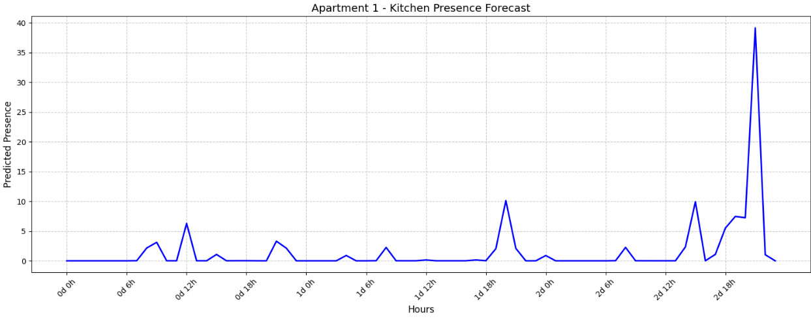
Room occupation prediction training
Train-Test split
Train and Evaluate models
Dump the models chosen

Slide 24
05
Automatization

Slide 25
Windows Task Scheduler
The data pipeline's operational reliability is done through tasks automation implemented using Windows Task Scheduler. This automation orchestrates the entire data flow across all layers, from initial data collection to predictive analytics and database loading.
Configuration
Data acquisition: Sensors data at 6:01 AM (1-minute repeat), Weather data at 6:01 AM (3-hour repeat)
Data cleaning: Sensors data at 6:06 AM (5-minute repeat), Weather data at 6:06 AM (3-hour repeat)
Data loading: Sensors data at 6:11 AM (5-minute repeat), Weather data at 6:11 AM (3-hour repeat)
Machine learning predictions: Energy consumption and Room presence forecasts at 10:30 PM daily, with results loaded at 11:00 PM

Slide 26
Execution features
Tasks run whether users are logged in or not for 24/7 operation
Complete execution history logging for monitoring and troubleshooting
Staggered scheduling prevents resource conflicts and task overlap
Working directory set to parent folder for proper relative path resolution
Tasks won't start if a previous instance of the same task is already running

Slide 27
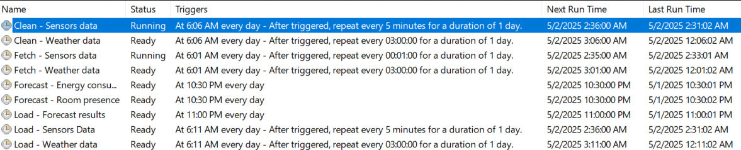
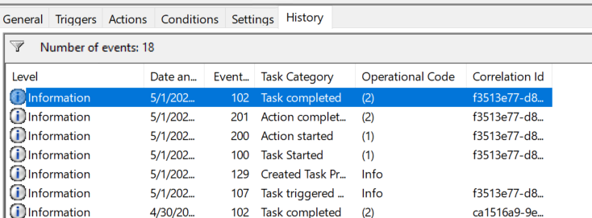
Monitoring
Instructions

Slide 28
06
PowerBI

Slide 29
Thanks for listening !
Do you have any questions?

